Slide 1
AML Check API
Prepared by Precious Pearl A. Sano

Slide 2
Problem Statement
The client admin user need an API that provide status hit or not hit about the status of the employee using the file information from employee and criteria template file from the AML.

Slide 3
Requirement
The API will validate hit or not status base on criteria and information both from employee and AML using file and third party integration with database.

Slide 4
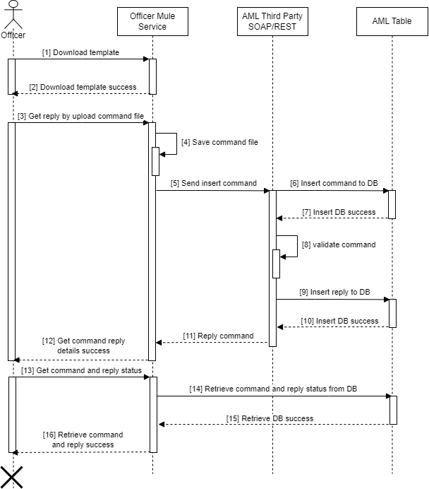
Project name and diagram
mas-aml-check

Slide 5
Flow ID and Description
THIRD PARTY
AML-ANY-COMMAND-SUBMISSION
AML Check Insert command with REST or SOAP format
AML-ANYLOAD-COMMAND-REPLY
Get AML Check reply with REST or SOAP format
INTERNAL
AML-INTERNAL-INSERT-COMMAND
AML Check Insert command direct to DEV_AML to save only inserted transaction.
EXTERNAL
(TODO FILE COMPONENT )AML- {SOAP | REST}-COMMAND-TEMPLATE
Get file and send rest and soap back to client.
(TABLE ROW COMPONENT) AML-EXTERNAL-TRANS-CLIENT-REPORT
Get history inserted in transaction client table.

Slide 6
Components, modules and Deployment Strategy
Listener configuration
Base path: /mas/aml-check/v1
Endpoints/flow old
1.) GET : /mas/aml-check/v1/external/command-template
2.) POST : /mas/aml-check/v1/external/command
3.) GET : /mas/aml-check/v1/external/command?replyId={commandId}
4.) POST : /mas/aml-check/v1/internal/command (central insert for 2 & 5)
5.) POST : /mas/aml-check/v1/external/command
Endpoints/flow new
1.) GET : /mas/aml-check/v1/external/{rest | soap}/command-template
2.) POST : /mas/aml-check/v1/external/{rest | soap}/command
3.) GET : /mas/aml-check/v1/external/command?replyId={commandId}
4.) POST : /mas/aml-check/v1/internal/command (central insert for 2 & 5)
5.) POST : /mas/aml-check/v1/external/command

Slide 7
Modules and Deployment Strategy
Core
Transformer
Set Payload
Set Variable
Components
Transform Message
custom type, flatten , variable,
externalize dw, root tag
Flow reference
Flow
Logger
Parse Template
Scopes
Until success
Try
Parallel For Each
Sub flow
Error handling
Error handler
On Error Continue
On Error Propagate
Raise error
Try Catch
Java
New
Invoke
Invoke Static
File
Read
Write
Consume
Request
Soap
Database
Select
Insert
On Table row
Deployment
On premise
Flow Control
Round Robin
First success
Choice
Scatter and Gather
Validation
Mock/Unit Test Strategy
Assert that
Mock when
Externalizing
Configuration Properties
Security Configuration

Slide 8
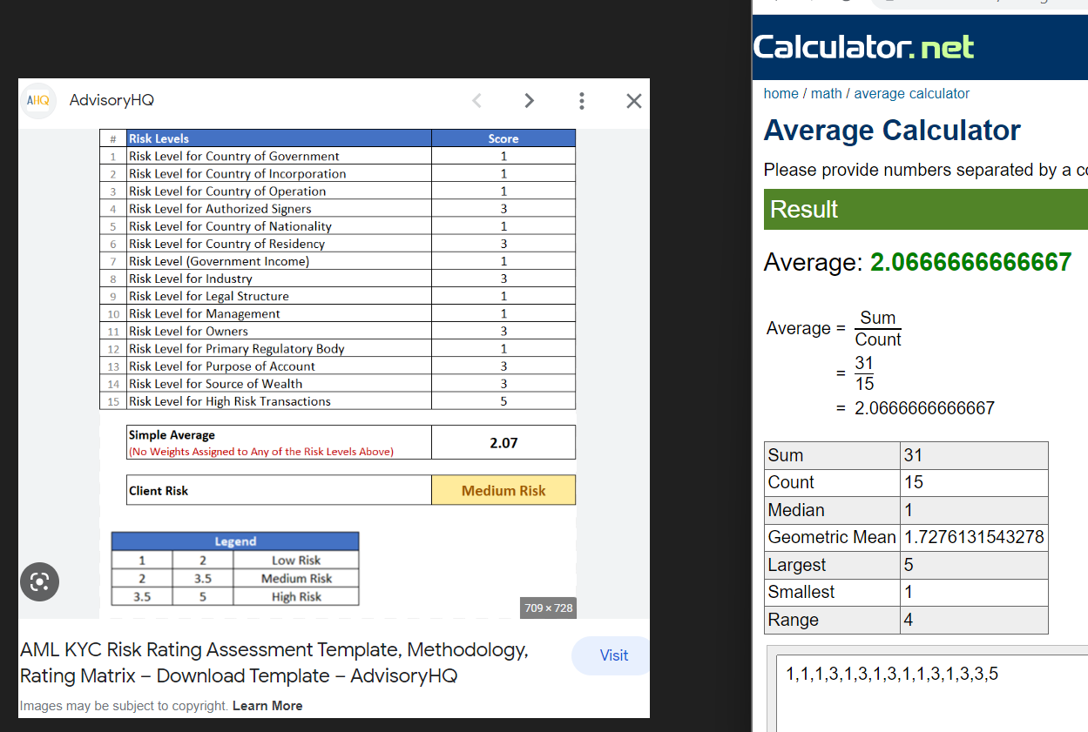
Validation calculation

Slide 9
THANK YOU!
Do you have any question?

